Slide 1

PROJECT TITLE : keylogger using python
CAPSTONE PROJECT
Presented By:
Name : Udhaiyalakshmi P
College Name : Kings Engineering College.
Department : Department of Computer Science

Slide 2
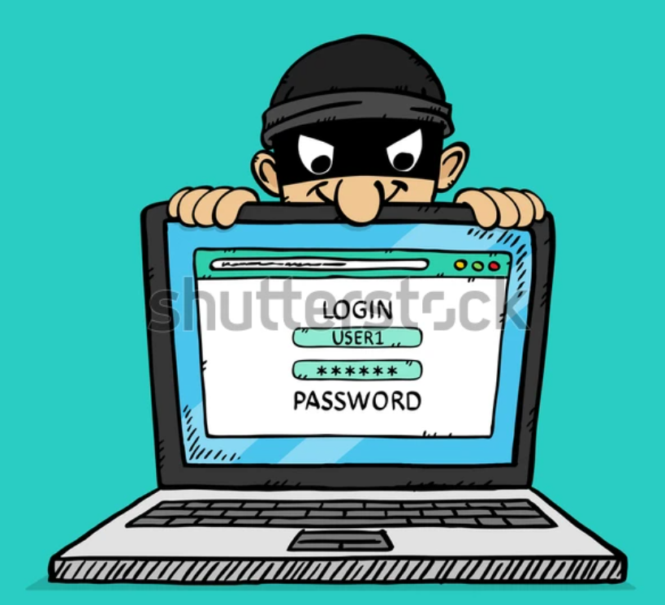
Outline:-
Problem Statement
Proposed System/Solution
System Development Approach
Algorithm & Deployment
Result (Output Image)
Conclusion
Future Scope
References

Slide 3


Problem Statement
Problem Statement:
Develop a keylogger to track keystrokes for monitoring purposes without compromising system security or violating user privacy.
Example Real-Time Issue:
Unauthorized individuals may use keyloggers to steal sensitive information such as passwords and credit card details by secretly recording keystrokes on a victim's computer without their knowledge or consent.

Slide 4
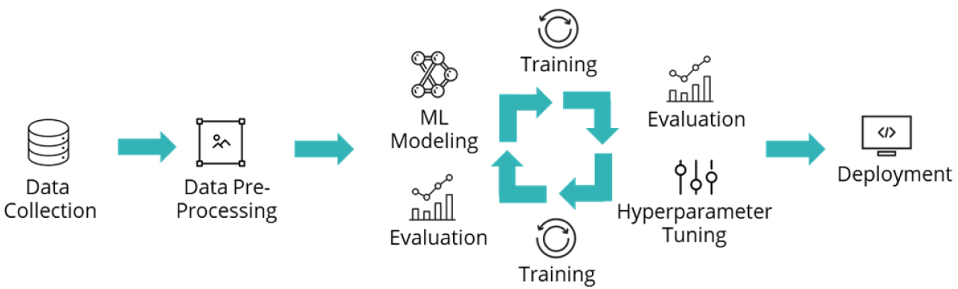
Proposed Solution
Implement a Python-based keylogger using tkinter and pynput libraries for capturing keyboard inputs discreetly and logging them into text and JSON formats.
Data Collection: The program captures keyboard inputs using the pynput library, distinguishing between key press, hold, and release events, and stores them in a list.
Data Preprocessing: No explicit data preprocessing is conducted in the program. The captured keyboard inputs are directly stored in memory and then saved into text and JSON files.
Machine Learning Algorithm: The program does not incorporate machine learning algorithms. It primarily focuses on event-driven programming to capture and log keystrokes without analyzing or interpreting the data.
Deployment: The keylogger application can be deployed on compatible systems where Python and the required libraries (tkinter, pynput) are installed. It operates discreetly in the background once initiated.
Evaluation: As the program lacks an evaluation process, there's no formal assessment of its performance or effectiveness in capturing keystrokes. Its functionality relies on correctly capturing and logging keyboard events.
Result: Upon execution, the keylogger runs discreetly, capturing and logging keyboard inputs into 'key_log.txt' and 'key_log.json' files, providing a record of keystrokes for monitoring purposes.

Slide 5

System Approach
System Development Approach: Employ Python programming with tkinter for GUI, pynput for keyboard monitoring, and JSON for structured data storage.
System requirements:
- Operating System: Compatible with platforms supporting Python (e.g., Windows, macOS, Linux).
- Python Version: Python 3.x installed.
- Libraries: tkinter, pynput.
Library required to build the model:
- tkinter: Used for creating the graphical user interface (GUI) to interact with the keylogger application.
-pynput: Utilized for capturing keyboard inputs, distinguishing between key press, hold, and release events, and enabling logging functionality.
-json: Employed for handling the conversion of Python data structures, such as lists, into JSON format for storage in the 'key_log.json' file.

Slide 6
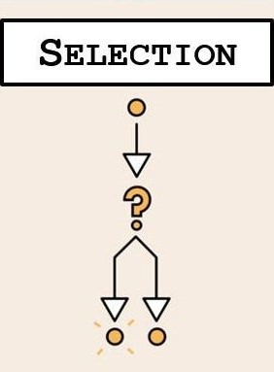



Algorithm & Deployment
Algorithm & Deployment: Utilize event-driven programming to capture keyboard events, logging them into text and JSON files. Deploy the application locally on compatible systems.
Algorithm Selection:The program utilizes an event-driven approach without employing a specific machine learning algorithm. Instead, it relies on capturing keyboard events using the pynput library and processing them to log keystrokes.
Data Input:Data input in this program involves capturing keyboard events, including key press, hold, and release actions. These events are monitored using the pynput library, enabling the program to track user input in real-time.
Training Process:As the program does not incorporate machine learning, there is no training process involved. However, the program's functionality can be considered as continuously training itself to capture and log keyboard inputs based on user interaction.
Prediction Process:Similarly, since there's no predictive modeling or machine learning involved, there's no explicit prediction process. The program records keyboard events as they occur, without predicting future actions or behaviors.

Slide 7

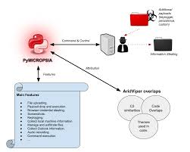
Result
Result: The keylogger operates discreetly, capturing keystrokes in real-time. It logs key press, hold, and release events, saving them into 'key_log.txt' and 'key_log.json' files for subsequent analysis and monitoring of user activity.

Slide 8
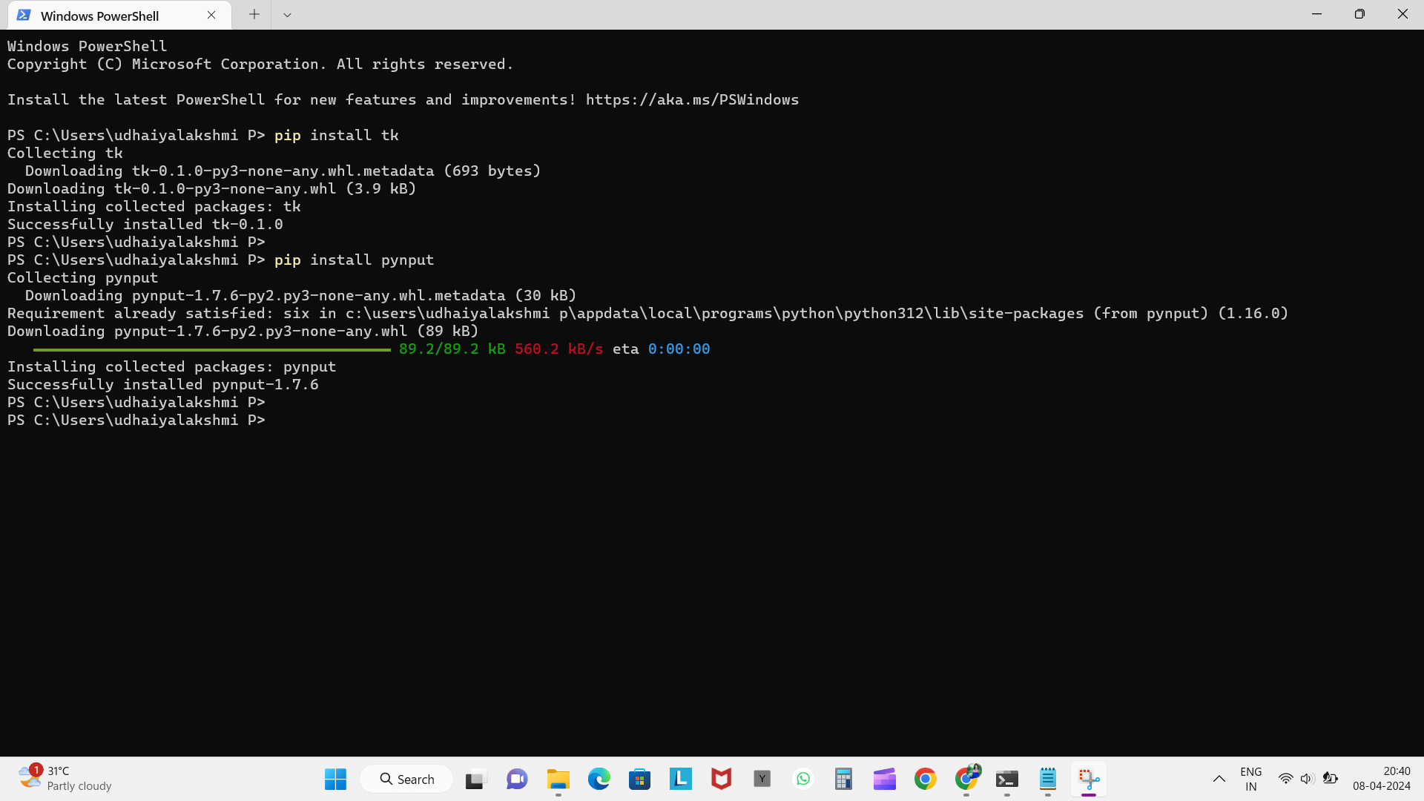
Keylogger program :-
Install necessary libraries using >pip install.

Slide 9
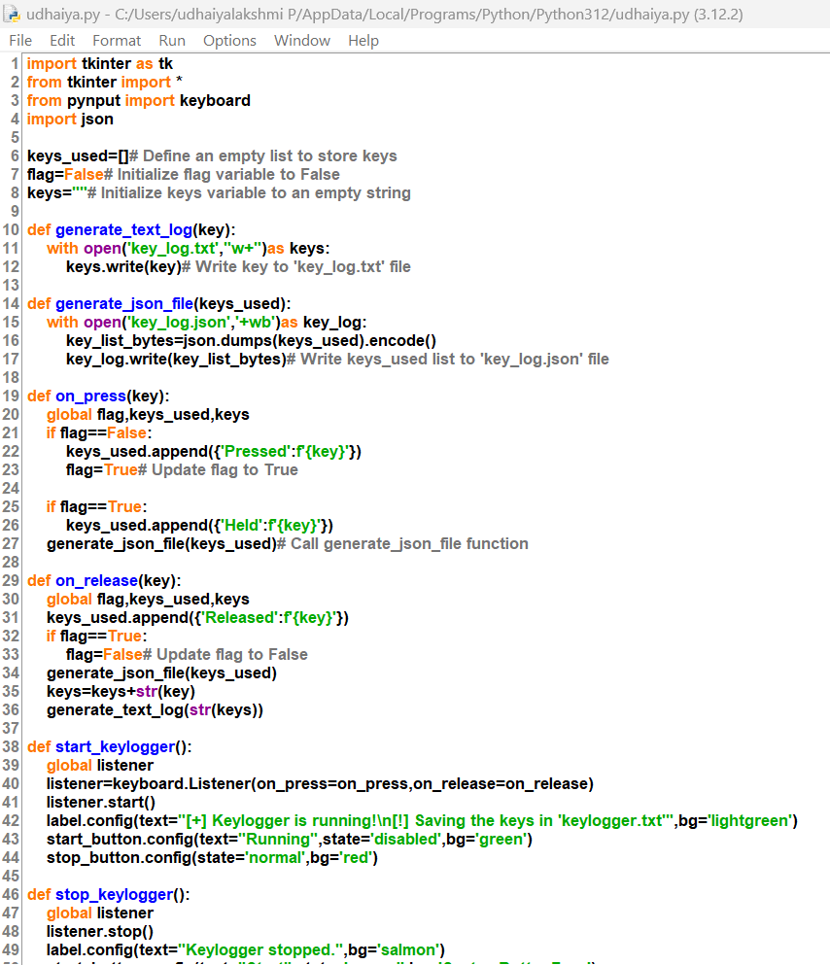
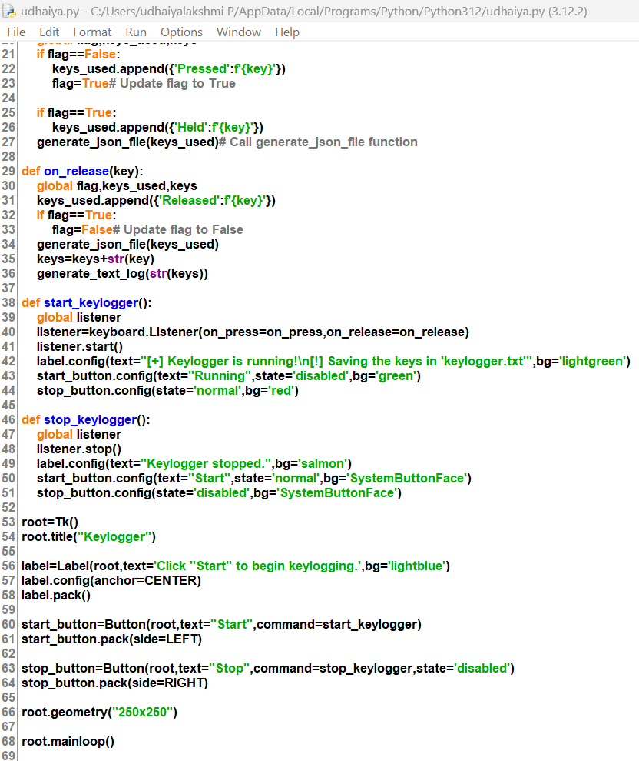
Keylogger program:-

Slide 10
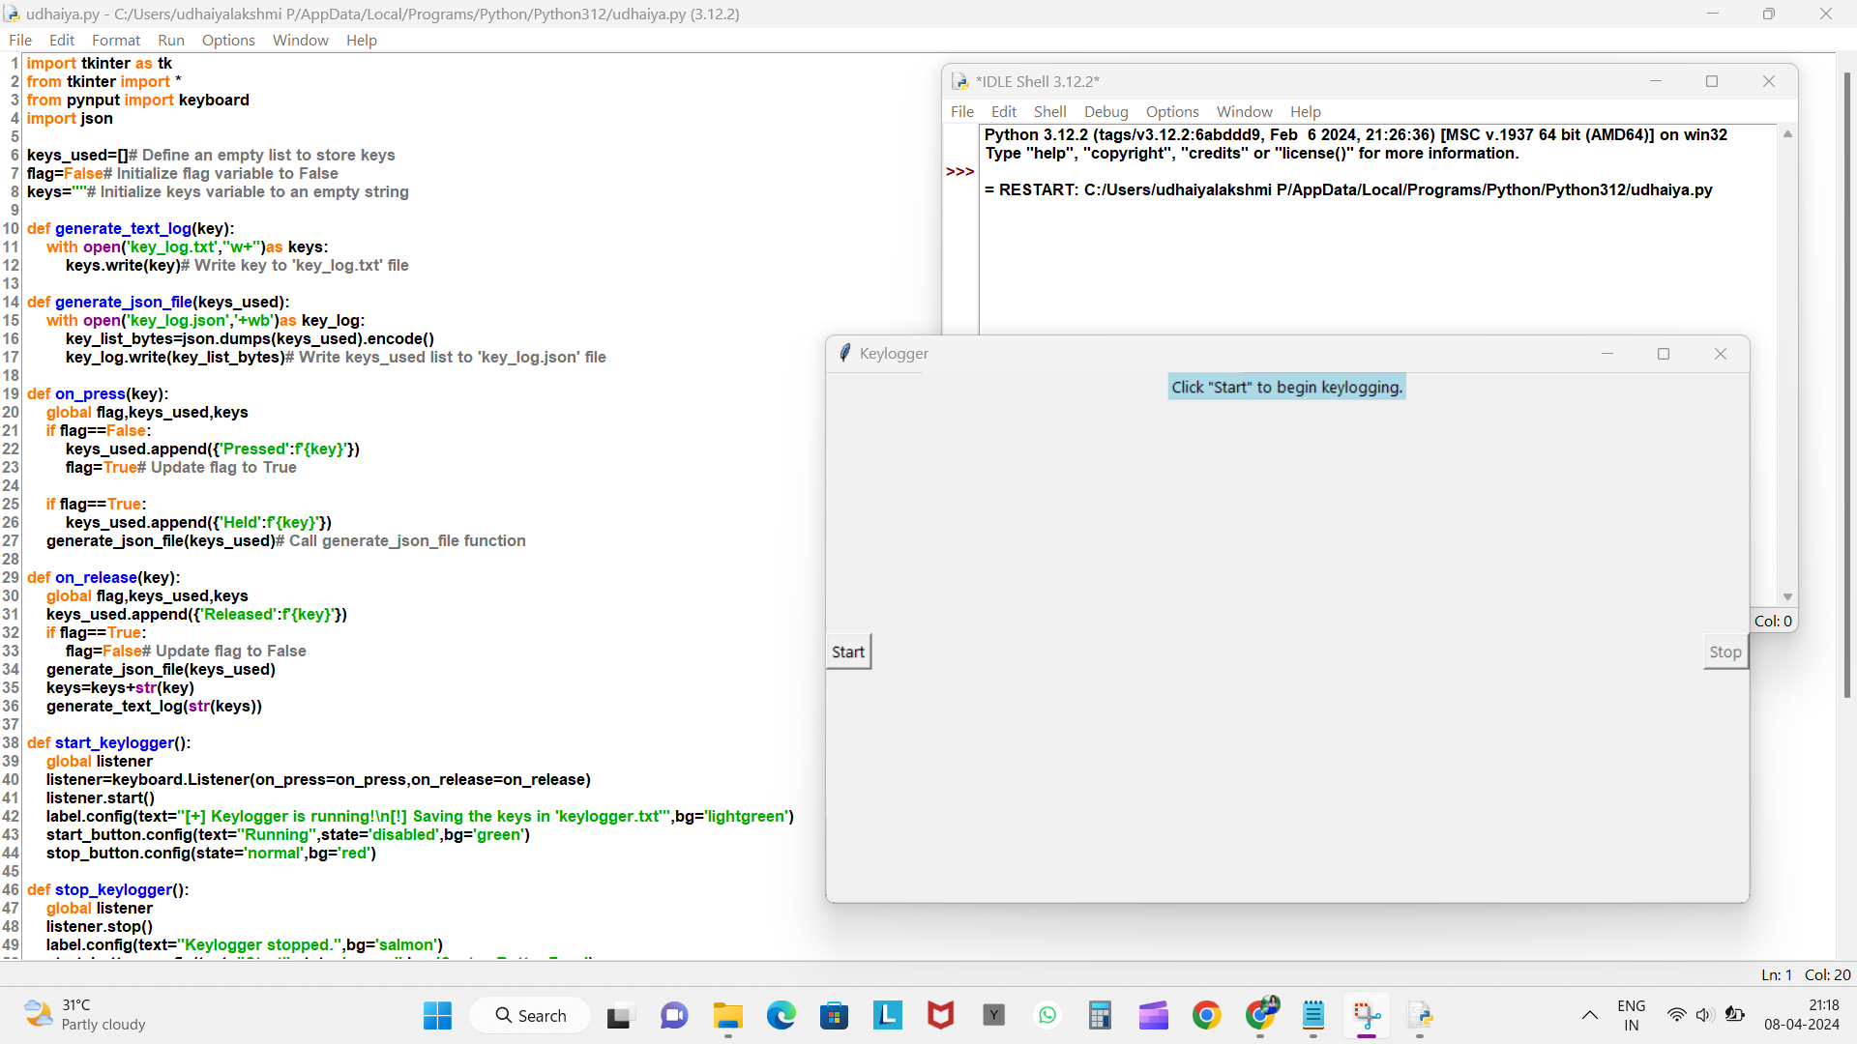
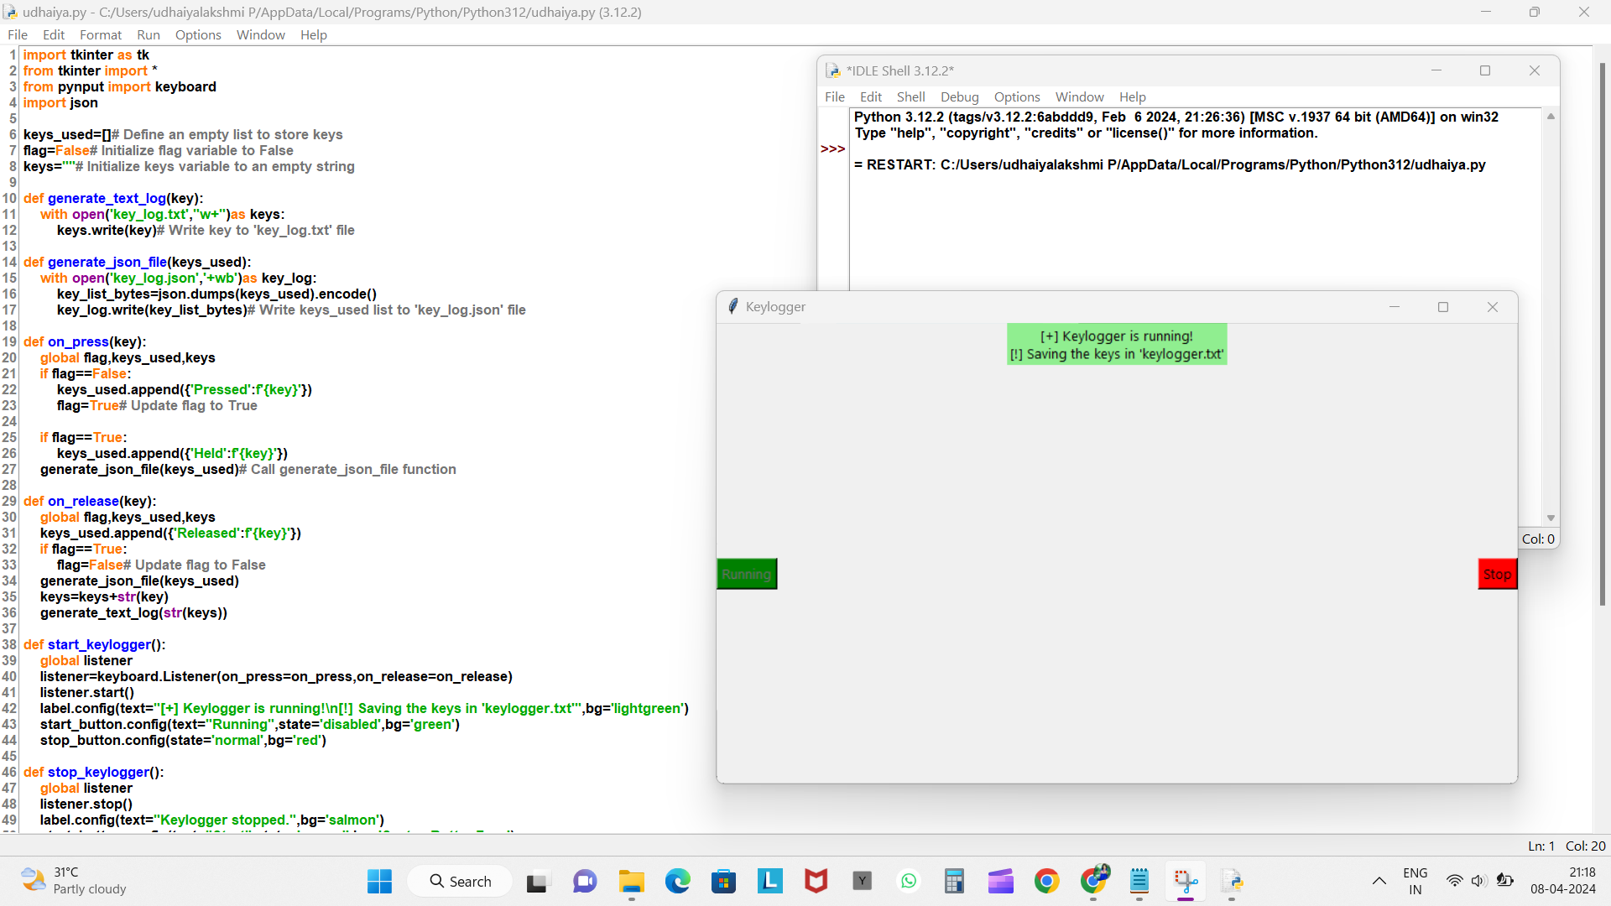
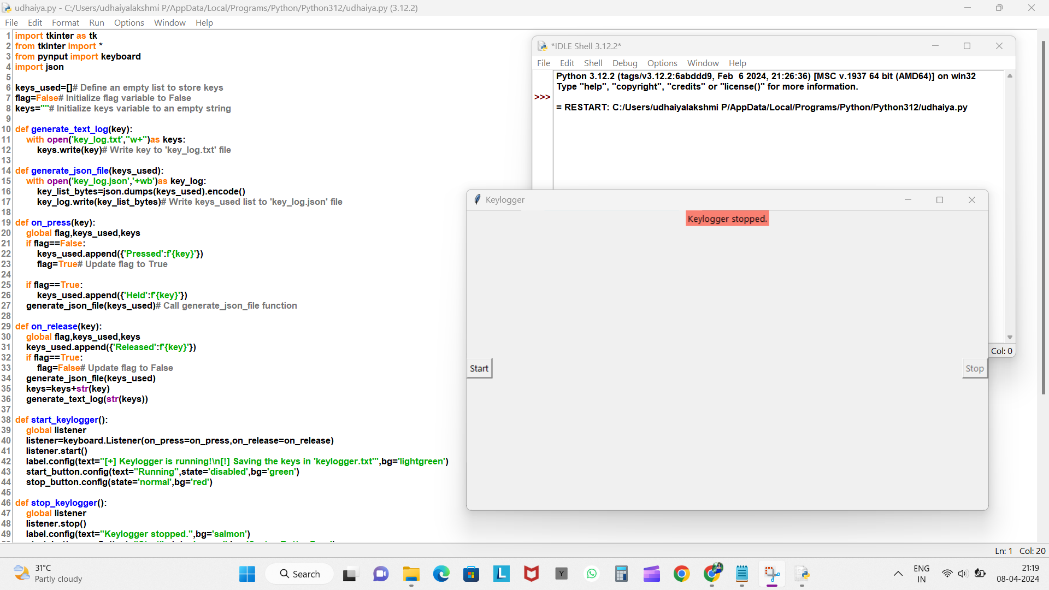
Output of keylogger program:-
1.
2.
3.

Slide 11
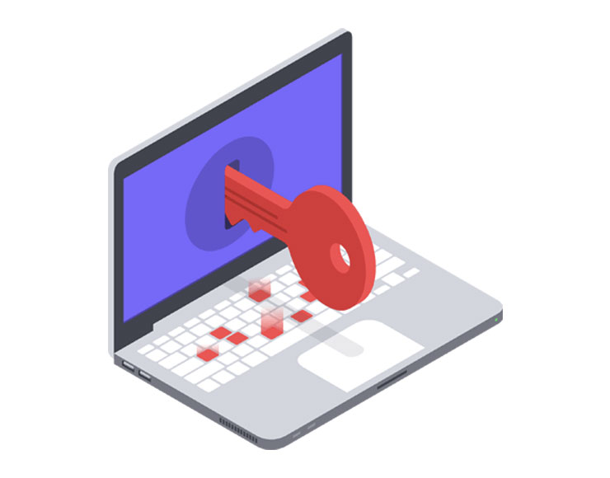
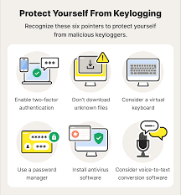
Conclusion
The keylogger program efficiently captures keyboard inputs, logging them discreetly into text and JSON files. While providing valuable insights into user activities, it emphasizes the importance of ethical considerations and user consent in monitoring practices. With its straightforward implementation and emphasis on privacy, it showcases a practical solution for observing user interactions while maintaining ethical standards. This program serves as a reminder of the delicate balance between monitoring for security purposes and respecting individual privacy rights, highlighting the significance of responsible data handling in today's digital landscape.

Slide 12








Future scope
The keylogger program can be expanded to incorporate advanced features such as data encryption to ensure secure storage of logged keystrokes. Additionally, implementing remote access functionality would allow for monitoring keystrokes from a distance, enhancing its utility for surveillance purposes. Integration with machine learning algorithms could enable sophisticated pattern analysis, facilitating the identification of specific typing behaviors or anomalies. These enhancements would elevate the program's effectiveness and applicability in various scenarios, ranging from cybersecurity to behavioral analysis, paving the way for a more comprehensive and versatile keylogging solution.
Real time application of keylogger
1. Cybersecurity Monitoring
2. User Behavior Analysis
3. Parental Control
4. Employee Monitoring
5. Forensic Investigations
6. Access Control Systems
7. Financial Transactions Monitoring
8. Network Security

Slide 13
References
Use of legal software products for computer monitoring, keylogger.org.
V. W. Berninger (Ed., 2012), Past, present, and future contributions of cognitive writing research to cognitive psychology. New York/Sussex: Taylor & Francis. ISBN 9781848729636.
John Leyden (2000-12-06). "Mafia trial to test FBI spying tactics: Keystroke logging used to spy on mob suspect using PGP". The Register. Retrieved 2009-04-19.
Andrew Kelly (2010-09-10). "Cracking Passwords using Keyboard Acoustics and Language Modeling".
Sarah Young (14 September 2005). "Researchers recover typed text using audio recording of keystrokes". UC Berkeley NewsCenter.
Maggi, Federico; Volpatto, Alberto; Gasparini, Simone; Boracchi, Giacomo; Zanero, Stefano (2011). A fast eavesdropping attack against touchscreens (PDF). 7th International Conference on Information Security.IEEE.doi:10.1109/ISIAS.2011.6122840.
M. Aslam, R. N. Idrees, M. M. Baig, and M. A. Arshad, “Antihook shield against the software key loggers,” in Proceedings of the National Conference of Emerging Technologies, 2004
L. Martignoni, E. Stinson, M. Fredrikson, S. Jha, and J. C. Mitchell, “A layered architecture for detecting malicious behaviors,” in RAID ’08: Proceedings of the 11th international symposium on Recent Advances in Intrusion Detection. Heidelberg: Springer-Verlag, 2008
D. Le, C. Yue, T. Smart, and H. Wang, “Detecting kernel level keyloggers through dynamic taint analysis,” College of William & Mary, Department of Computer Science, Williamsburg, VA, Tech. Rep. WM-CS-2008-05, May 2008.
B. Cogswell and M. Russinovich, “Rootkitrevealer v1.71,” 2006 (accessed May 8, 2010), http://technet.microsoft.com/en-us/sysinternals/ bb897445.aspx.
C. Wood and R. K. Raj, “Sample keylogging programming projects,” 2010 (accessed May 8, 2010), http://www.cs.rit.edu/~rkr/ keylogger2010.
B. Whitty, “The ethics of key loggers,” Article on Technibble.com, June 2007 (accessed May 8, 2010), http://www.technibble.com/ the-ethics-of-keyloggers/.
J. Todd, “Clandestine file system driver,” 2005 (accessed May 8, 2010), http://www.rootkit.com/newsread.php?newsid=386.

Slide 14

…THANK YOU…

